Slide 1


Data Mining
Digital Business Ecosystem Research Center, Telkom University

Slide 2
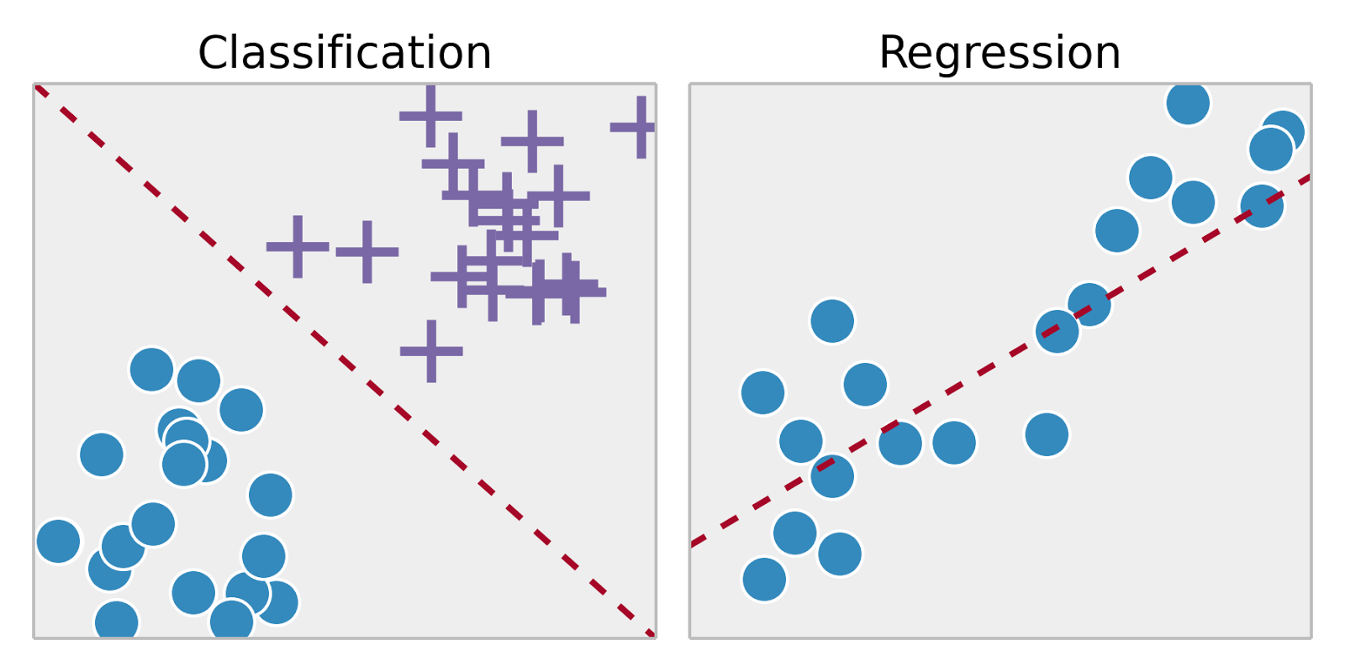
Supervised Learning
Classification
Regression
Supervised Learning approach is indeed like human learning under the supervision of a teacher. The teacher provides good examples for the student to memorize, and the student then derives general rules from these specific examples. Some classification problem are:
Classification: A classification problem is when the output variable is a category or a group, such as “black” or “white” or “spam” and “no spam”.
Regression: A regression problem is when the output variable is a real value, such as “weight” or “height.”

Slide 3
Regression
Regression analysis is a form of predictive modelling technique which investigates the relationship between a dependent (target) and independent variable (s) (predictor). Regression analysis is an important tool for modelling and analyzing data.
Regression analysis is used to:
Predict the value of a dependent variable based on the value of at least one independent variable
Explain the impact of changes in an independent variable on the dependent variable

Slide 4
Regression
Regression analysis is a form of predictive modelling technique which investigates the relationship between a dependent (target) and independent variable (s) (predictor). Regression analysis is an important tool for modelling and analyzing data.
Regression analysis is used to:
Predict the value of a dependent variable based on the value of at least one independent variable
Explain the impact of changes in an independent variable on the dependent variable

Slide 5
Regression
Regression Models
Simple
Multiple
Linear
Linear
Non-Linear
Non-Linear
1 Explanatory
Variable
2+ Explanatory
Variables

Slide 6
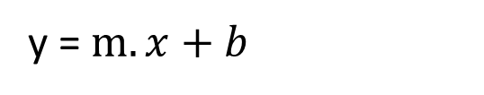
Linear Regression
Linear regression performs the task to predict a dependent variable value (y) based on a given independent variable (x). So, this regression technique finds out a linear relationship between x (input) and y(output).
y = $m.x+b$
y = $slope.x+intercept$

Slide 7
Classification
In machine learning and statistic, classification is the problem of identifying to which of a set of categories (sub-populations) a new observation belongs, based on a training set of data containing observations (or instances) whose category membership is known.
Examples:
Assigning a given email to the “spam” or “non-spam” class,
Assigning a customer will be churn or not.

Slide 8
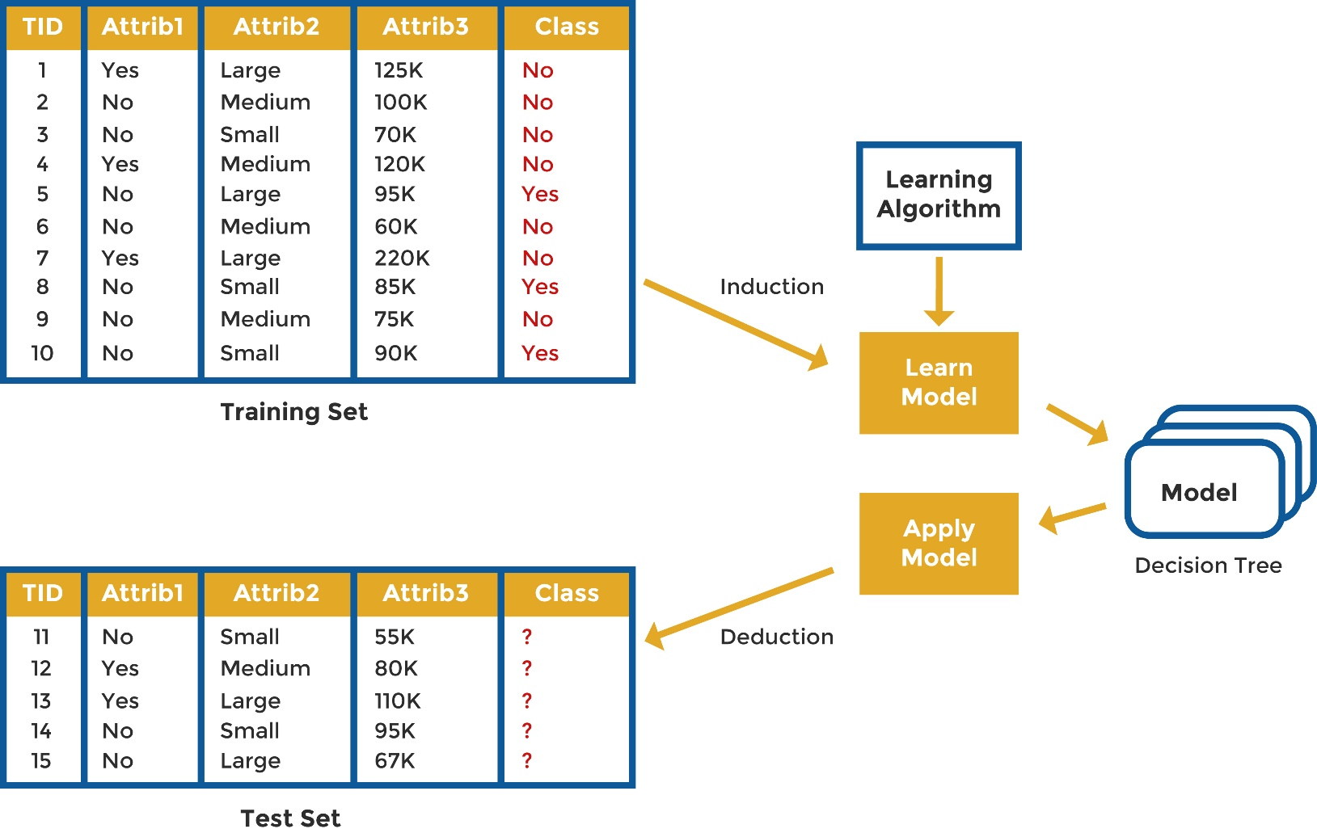
Classification
Several Classification Algorithm:
Decision Tree
Naïve Bayes
KNN
Random Forest

Slide 9
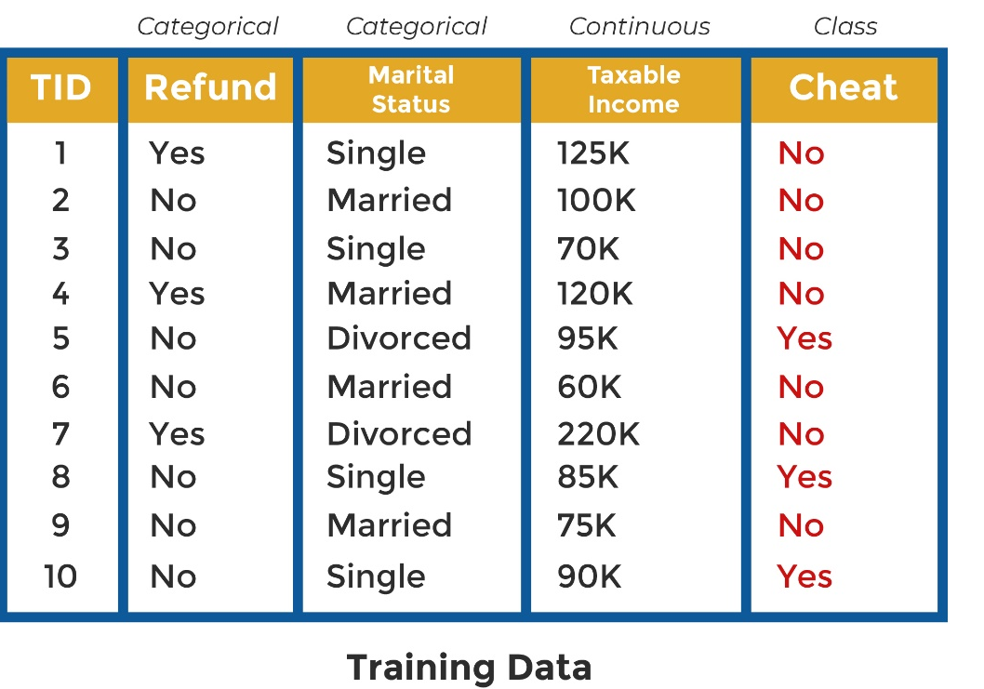

Decision Tree
Decision tree is a tree shaped diagram used to determine a course of action. Each branch of the tree represents a possible decision, occurrence or reaction

Slide 10
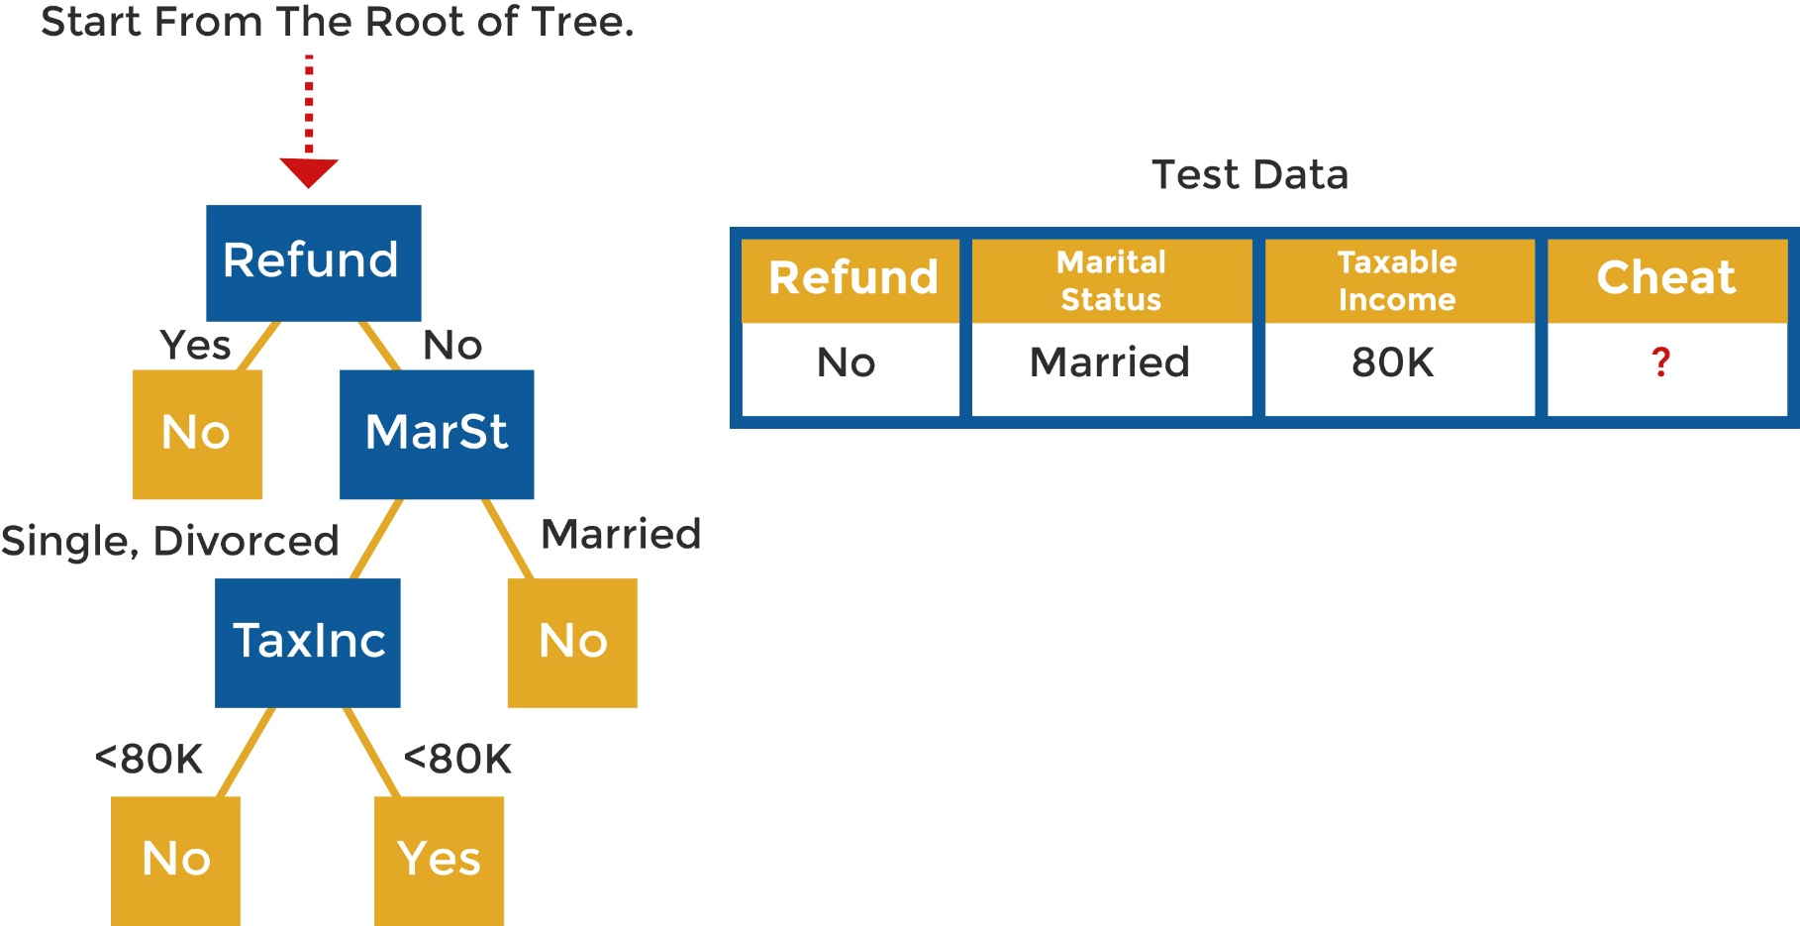
Decision Tree
Apply to Test Data

Slide 11
Naïve Bayes
Based on Bayes Theorem
Given:
A doctor knows that meningitis causes stiff neck 50% of the time
Prior probability of any patient having meningitis is 1/50,000
Prior probability of any patient having stiff neck is 1/20
If a patient has stiff neck, what’s the probability he/she has meningitis?

Slide 12
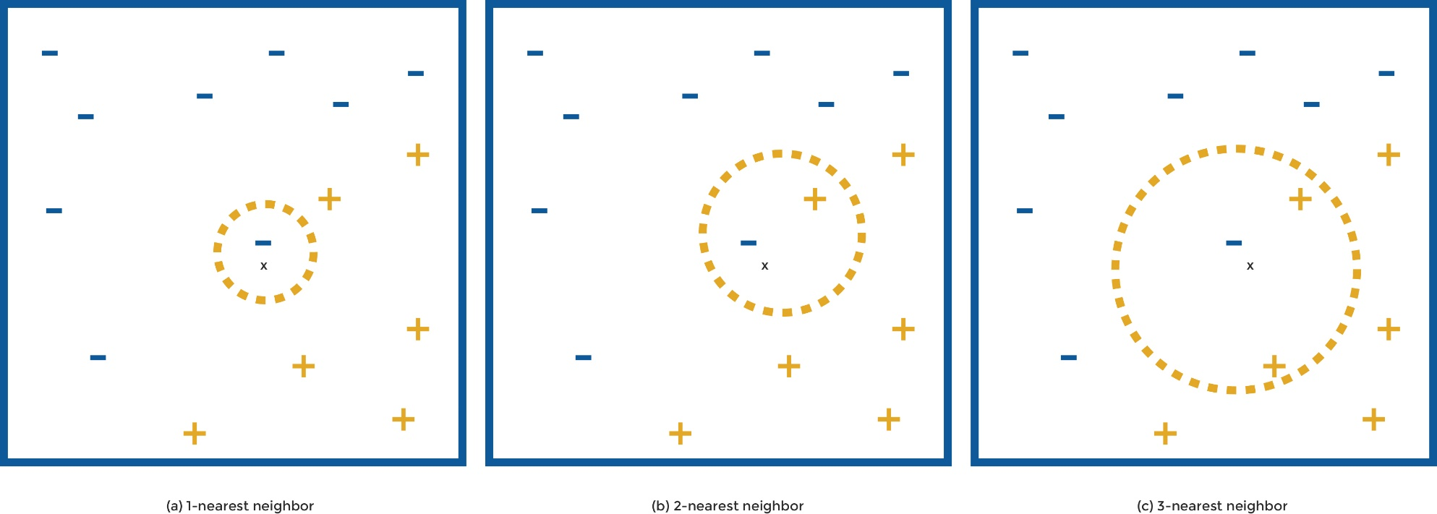

Nearest Neighbor
K-nearest neighbors of a record x are data points that have the k smallest distance to x

Slide 13
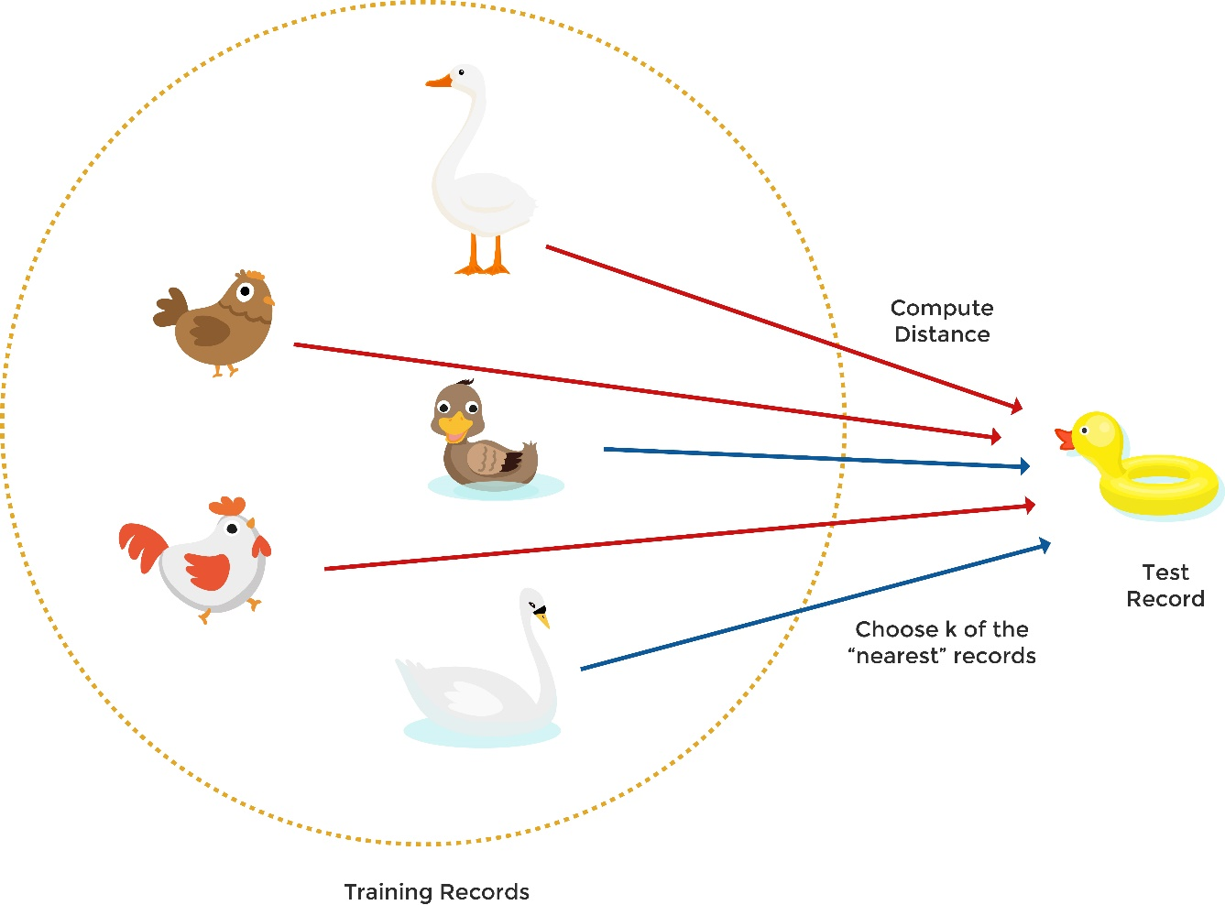
Nearest Neighbor
Basic idea:
If it walks like a duck, quacks like a duck, then it’s probably a duck

Slide 14
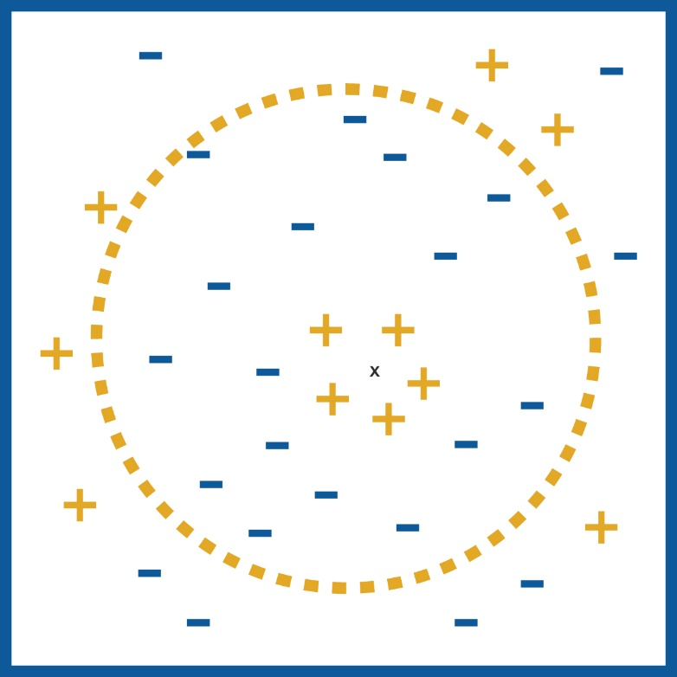
Nearest Neighbor
Choosing the value of k:
If k is too small, sensitive to noise points
If k is too large, neighborhood may include points from other classess
k-NN classifiers are lazy learners
It does not build models explicitly
Unlike eager learners such as decision tree induction and rule-based systems
Classifying unknown records are relatively expensive

Slide 15
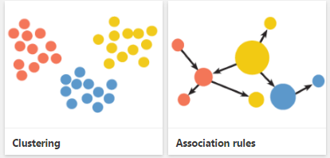
Unsupervised Learning
Mathematically, Unsupervised learning is where you only have input data (X) and no corresponding output variables. The goal for unsupervised learning is to model the underlying structure or distribution in the data in order to learn more about the data.
Clustering: Grouping a set of objects in such a manner that objects in the same group are more similar than to those object belonging to other groups.
Association: Finding associations amongst items within large commercial databases.

Slide 16
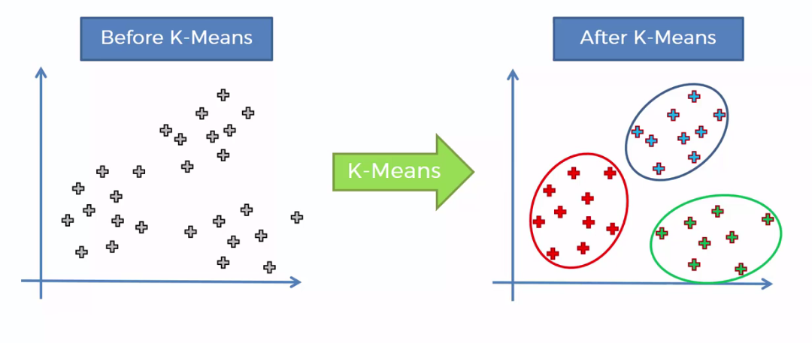
Clustering
Clustering is the classification of objects into different groups, or more precisely, the partitioning of a data set into subsets (clusters), so that the data in each subset (ideally) share some common trait - often according to some defined distance measure.

Slide 17
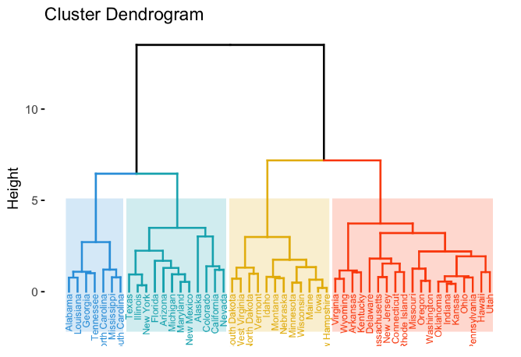
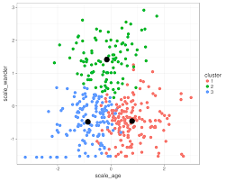
Types of Clustering
Hierarchical algorithms: these find successive clusters using previously established clusters.
Agglomerative ("bottom-up"): Agglomerative algorithms begin with each element as a separate cluster and merge them into successively larger clusters.
Divisive ("top-down"): Divisive algorithms begin with the whole set and proceed to divide it into successively smaller clusters.
Partitional clustering: Partitional algorithms determine all clusters at once. They include:
K-means and derivatives
Fuzzy c-means clustering
QT clustering algorithm

Slide 18
K-Means Clustering
The k-means algorithm is an algorithm to cluster n objects based on attributes into k partitions, where k < n.
Simply speaking k-means clustering is an algorithm to classify or to group the objects based on attributes/features into K number of group
K is positive integer number.
The grouping is done by minimizing the sum of squares of distances between data and the corresponding cluster centroid.

Slide 19
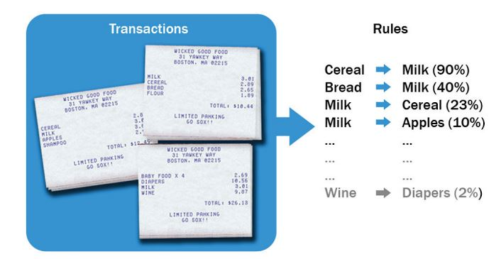
Association Rule Mining
Association used when we want to find an association between different objects in a set, find frequent patterns in a database. Some possible question that association rules can answer:
Which product tend to be purchased together?
Of those customer who are like this person, what product do they tend to buy?
Of those customer who have purchased this product, what other similar products do they tend to view or purchase?
Source: Data Science and Big Data Analytics Book -Wiley

Slide 20
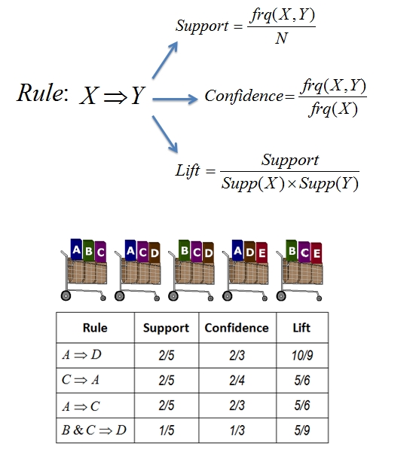
Association Rule
Support: Fraction of transactions containing the itemset
Confidence: Probability of occurrence of {Y} given {X} is present
Lift: Ratio of confidence to baseline probability of occurrence of {Y}
Source: https://towardsdatascience.com/a-gentle-introduction-on-market-basket-analysis-association-rules-fa4b986a40ce

Slide 21

Thank You
Every Ending Is Really Just A New Beginning

